Slide 1

Database Management Systems: A Comprehensive Overview
Welcome! Today we'll explore the world of Database Management Systems (DBMS), understanding their vital role in modern computing. We'll cover fundamental concepts, architectural designs, and emerging trends shaping the future of data management.
by Yash Panchal ,Devarsh Prajapati , Sanskuti Bosiya

Slide 2
The Power of DBMS in Modern Computing
DBMS facilitate efficient data storage and retrieval, enabling organizations to manage massive volumes of information.
They provide a robust foundation for various applications, such as e-commerce platforms, social media networks, and financial systems.
DBMS empower data-driven decision making by offering analytical tools for extracting insights and trends from stored data.

Slide 3
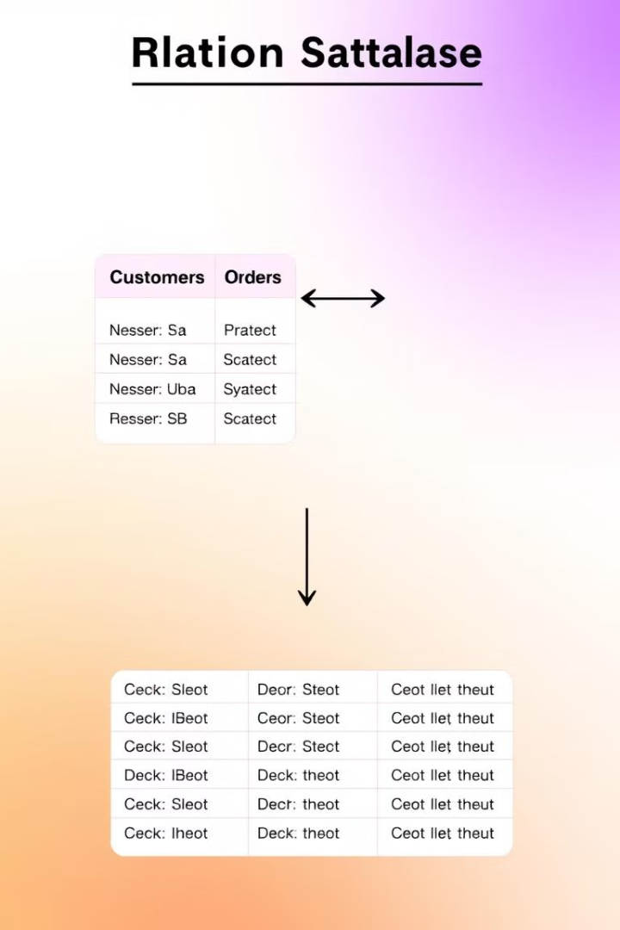
Fundamental DBMS Concepts
Data Models
Schemas
Represent the logical structure of data, defining relationships between entities.
Describe the organization of data within the database, specifying data types and constraints.
Queries
Used to retrieve, manipulate, and update data stored in the database.

Slide 4


Relational Databases and SQL
Relational Model
SQL
Organizes data into tables with rows and columns, enforcing relationships between data entities.
A structured query language used to interact with relational databases, defining queries, data manipulation, and control operations.

Slide 5
Database Design Principles
Normalization
1
Eliminates data redundancy and promotes data consistency.
Entity-Relationship Modeling
2
Represents relationships between entities in a database, providing a visual blueprint for database design.

Slide 6

Data Storage, Indexing, and Optimization
1
Different storage techniques, like file systems and block storage, optimize for specific needs.
2
Indexing allows faster data retrieval by creating searchable data structures within the database.
3
Optimization techniques include query tuning, database clustering, and data compression to improve performance and efficiency.

Slide 7

DBMS Security, Transactions, and Concurrency Control
1
Security Measures
2
Transactions
3
Concurrency Control
Protect sensitive data through authentication, authorization, and encryption.
Ensure data integrity by treating database operations as atomic units.
Manages simultaneous access to data, preventing data corruption and inconsistencies.

Slide 8



Emerging Trends and Technologies
Cloud Databases
1
Offer scalable and on-demand database services.
NoSQL Databases
2
Provide flexible and distributed data management solutions.
AI-powered Database Optimization
3
Automate database performance tuning and data management.

